Slide 1
STRATEGIC DECISION MAKING
Chapter 2

Slide 2
Decision Making
Organizations must:
Analyze large amounts of information
Make decisions quickly
Apply sophisticated analysis techniques
Protect the corporate asset of organizational information

Slide 3

Decision Making (contd.)
Model – a simplified representation or abstraction of reality
Have you worked with a Decision Support System?

Slide 4
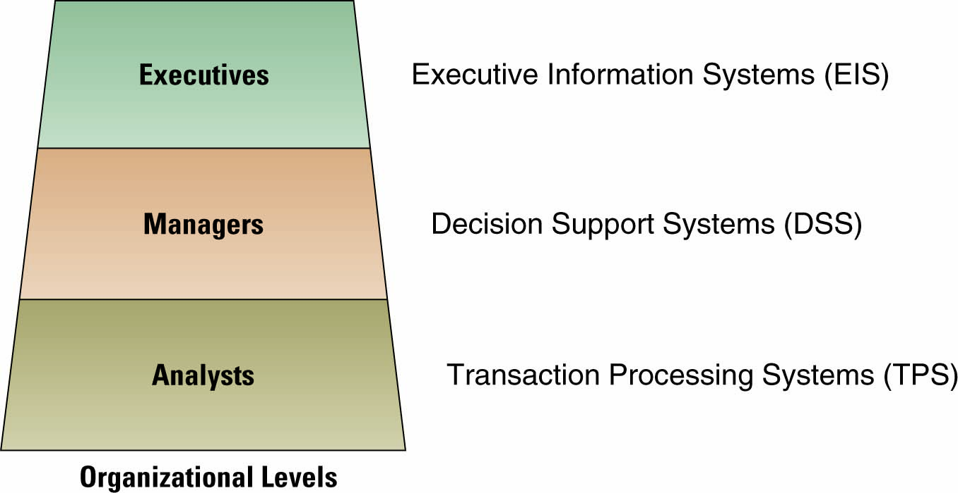
IT Systems in an Enterprise

Slide 5
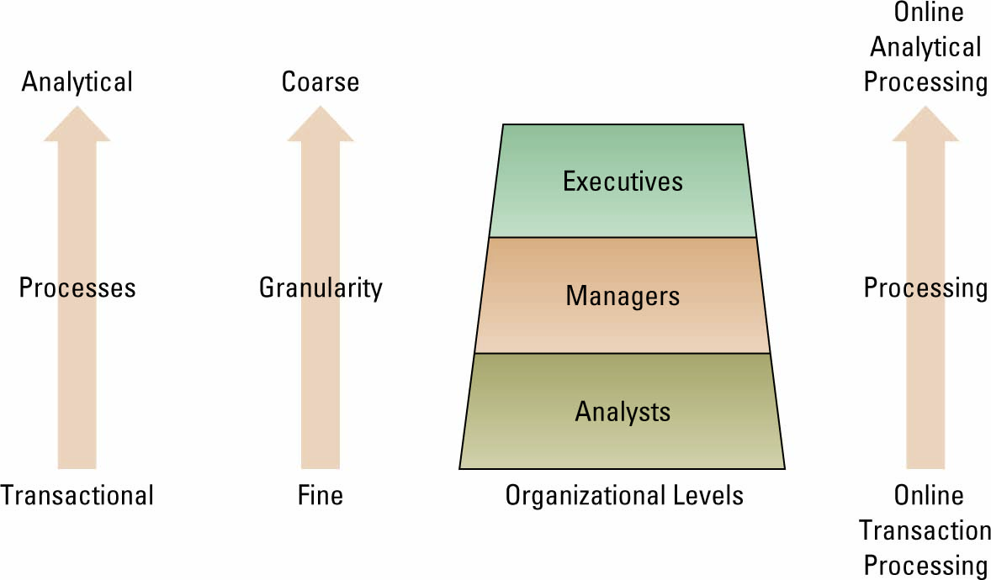
Transaction Processing Systems
Moving up users move from requiring transactional information to analytical information

Slide 6
Transaction Processing Systems (contd.)
Transaction processing system (TPS)
Basic business system that serves the operational level
Online transaction processing (OLTP)
Capturing of transaction and event information using technology
Online analytical processing (OLAP)
Manipulation of information to create business intelligence in support of strategic decision making

Slide 7
Decision Support Systems
Decision support system (DSS) – models information to support managers and business professionals during the decision-making process
Three quantitative models used by DSSs include:
Sensitivity analysis
What-if analysis
Goal-seeking analysis

Slide 8
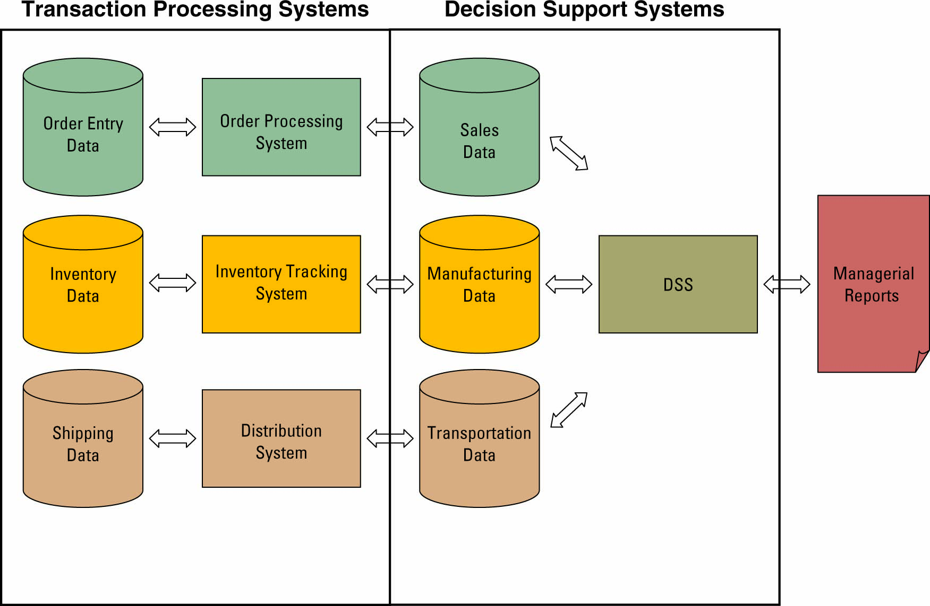
Interaction between a TPS and a DSS

Slide 9
Executive Information Systems
Executive information system (EIS)
A specialized DSS that supports senior level executives within the organization
Most EISs offering the following capabilities:
Consolidation
Drill-down
Slice-and-dice

Slide 10
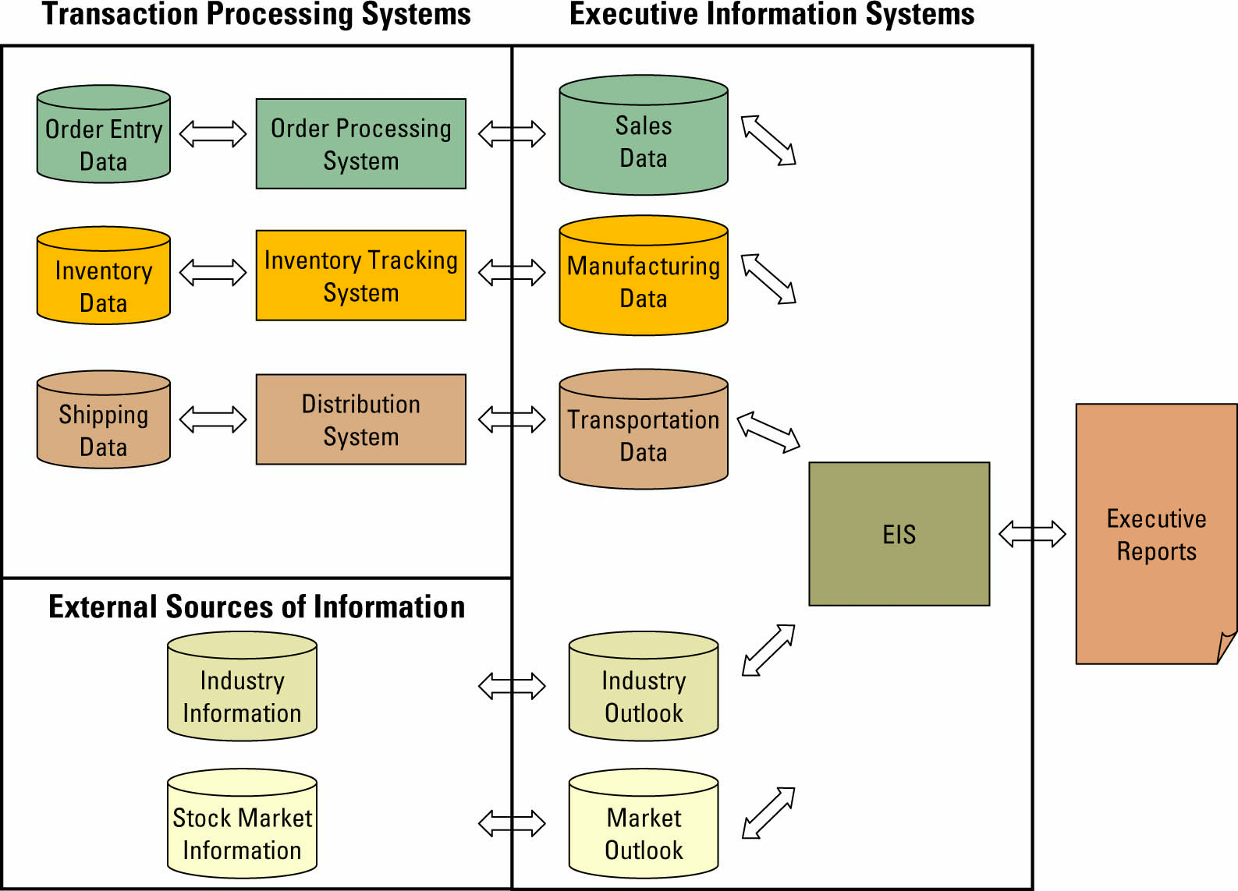
Interaction between a TPS and an EIS

Slide 11
Artificial Intelligence (AI)
Intelligent system – various commercial applications of artificial intelligence
Artificial intelligence (AI) – simulates human intelligence such as the ability to reason and learn

Slide 12
Common Categories of AI
Expert system
Computerized advisory programs that imitate the reasoning processes of experts in solving difficult problems
Neural Network
Attempts to emulate the way the human brain works
Fuzzy logic
A mathematical method of handling imprecise or subjective information

Slide 13
Common Categories of AI (contd.)
Genetic algorithm
An artificial intelligent system that mimics the evolutionary, survival-of-the-fittest process to generate increasingly better solutions to a problem
Intelligent agent
Special-purposed knowledge-based information system that accomplishes specific tasks on behalf of its users

Slide 14
Data Mining
Data-mining systems sift instantly through information to uncover patterns and relationships
Data-mining systems include many forms of AI such as neural networks and expert systems

Slide 15
Business Process Reengineering

Slide 16
Overview
Problems with traditional organizations
Business Process Reengineering (BPR)
Definition of BPR
Business process
BPR case studies
BPR & CRM
Present state of BPR
Redesign principles and tactics
Best practices

Slide 17

What is a Business Process?
A structured, measured set of
activities designed to produce a
specified output for a particular
customer or market. It implies a
strong emphasis on how work is
done within an organization
Tom Davenport (BPR Expert)

Slide 18
Problems with Traditional Organizations
Lack of customer focus
Internal empires
Priorities conflicts
Lack of innovation
Lack of flexibility
“Buffers” of time
“Buffers” of inventory
“Buffers” of quality
Duplication & redundancy

Slide 19
What is the Reason?
I
I
N
M
J
It
Is
Not
My
Job

Slide 20
What is BPR?
Business Process Reengineering
Aims to achieve quantum improvements
By rethinking and redesigning the way that business processes are carried out
By using IT as the primary facilitator/enabler

Slide 21
Main Characteristics of Business Processes
Respond to a business objective
Oriented toward a customer
Create value (have a deliverable)
Are constituted by a sequence of activities
Cross organizational/departmental boundaries
Have partners
Are repetitive
Are measurable

Slide 22
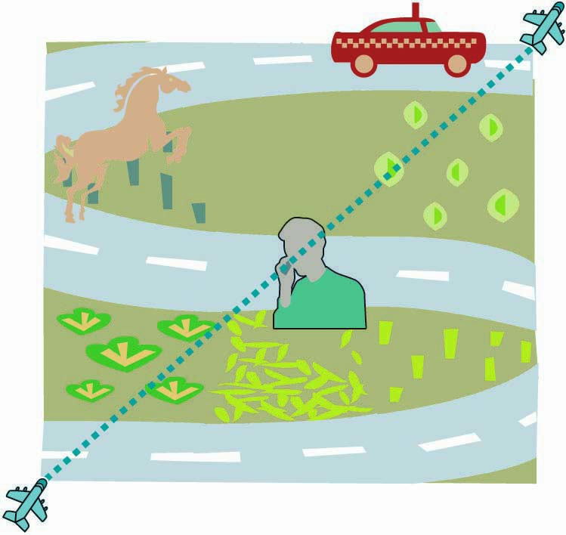
Finding Opportunity Using BPR
A company can improve the way it travels the road by moving from foot to horse and then horse to car
BPR looks at taking a different path, such as an airplane which ignore the road completely

Slide 23
Traditional vs. Process Vision
Traditional vision
Bureaucracy
Efficiency
Cost
Activities and Tasks
Complexity
Management
Process vision
Customer
Effectiveness
Time
Roles and responsibilities
Simplicity
Leadership
What we do
What we produce

Slide 24
BPR for CRM
BPR for CRM involves
rethinking and redesigning
business processes to
create value to customers.
People
Processes
Technology

Slide 25
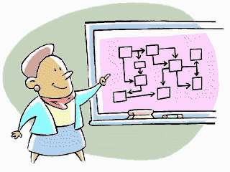

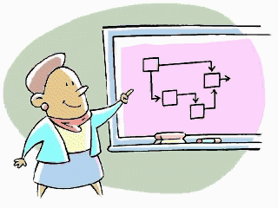
BPR is Crucial for CRM
BPR helps companies to transform from a bureaucratic to a customer-centered orientation
By reducing process time and improving quality

Slide 26
BPR Characteristics
Seeking of dramatic levels of improvements
Break-away from outdated rules and fundamental assumptions that underlie operations
Break-away from the constraints of organizational boundaries
Broad and cross-functional in scope
One-time change

Slide 27
BPR Characteristics (contd.)
Information technology is the primary enabler
BUT: Other enablers (structure, management style, facilities, measurement, compensation) need to be considered as well
Focus is on internal and/or external customers
Risky

Slide 28
Potential BPR Impacts
Dramatic productivity improvements
Dramatic product and service quality improvements
Cost reduction/efficiency gains
Improvement in organizational quality
Increase of market coverage

Slide 29
BPR Case Study
Ford Motors: Reengineering the accounts payable department
Results of BPR effort
Reduction of paper flow
(“invoiceless processing”)
Up-to-date data
Personnel reduction by 75%
Accurate financial information

Slide 30




Ford: The Traditional Process
Vendor
Purchasing
Receiving
Accounts Payable

Slide 31
Ford: The Traditional Process
Vendor
Purchase Order
Purchasing
Receiving
Copy of Purchase Order
Accounts Payable

Slide 32
Ford: The Traditional Process
Vendor
Purchase Order
Purchasing
Receiving
Goods
Copy of Purchase Order
Invoice
Accounts Payable

Slide 33
Ford: The Traditional Process
Vendor
Purchase Order
Purchasing
Receiving
Goods
Receiving Document
Copy of Purchase Order
Invoice
Accounts Payable

Slide 34
Ford: The Traditional Process
Vendor
Purchase Order
Purchasing
Receiving
Goods
Receiving Document
Copy of Purchase Order
Invoice
Accounts Payable
Payment

Slide 35


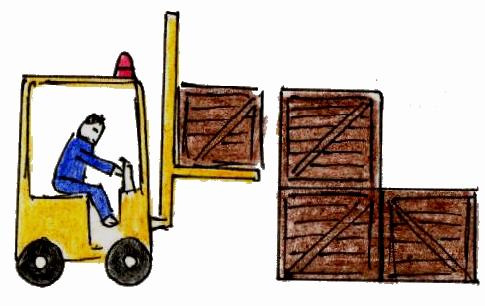

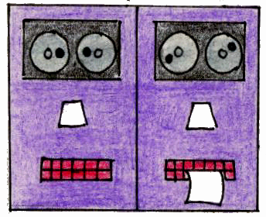
Ford: Reengineered Procedure Enabled by IT
Vendor
Purchasing
Receiving
Database
Accounts Payable

Slide 36
Ford: Reengineered Procedure Enabled by IT
Purchase Order
Vendor
Purchasing
Receiving
Database
Accounts Payable

Slide 37
Ford: Reengineered Procedure Enabled by IT
Purchase Order
Vendor
Purchasing
Receiving
Goods
Database
Accounts Payable

Slide 38
Ford: Reengineered Procedure Enabled by IT
Purchase Order
Vendor
Purchasing
Receiving
Goods
Database
Accounts Payable

Slide 39
Ford: Reengineered Procedure Enabled by IT
Purchase Order
Vendor
Purchasing
Receiving
Goods
Database
Accounts Payable

Slide 40
Ford: Reengineered Procedure Enabled by IT
Purchase Order
Vendor
Purchasing
Receiving
Payment
Goods
Database
Accounts Payable

Slide 41
Ford: Reengineered Procedure Enabled by IT
Purchase Order
Vendor
Purchasing
Receiving
Payment
Goods
Database
Accounts Payable

